Slide 1
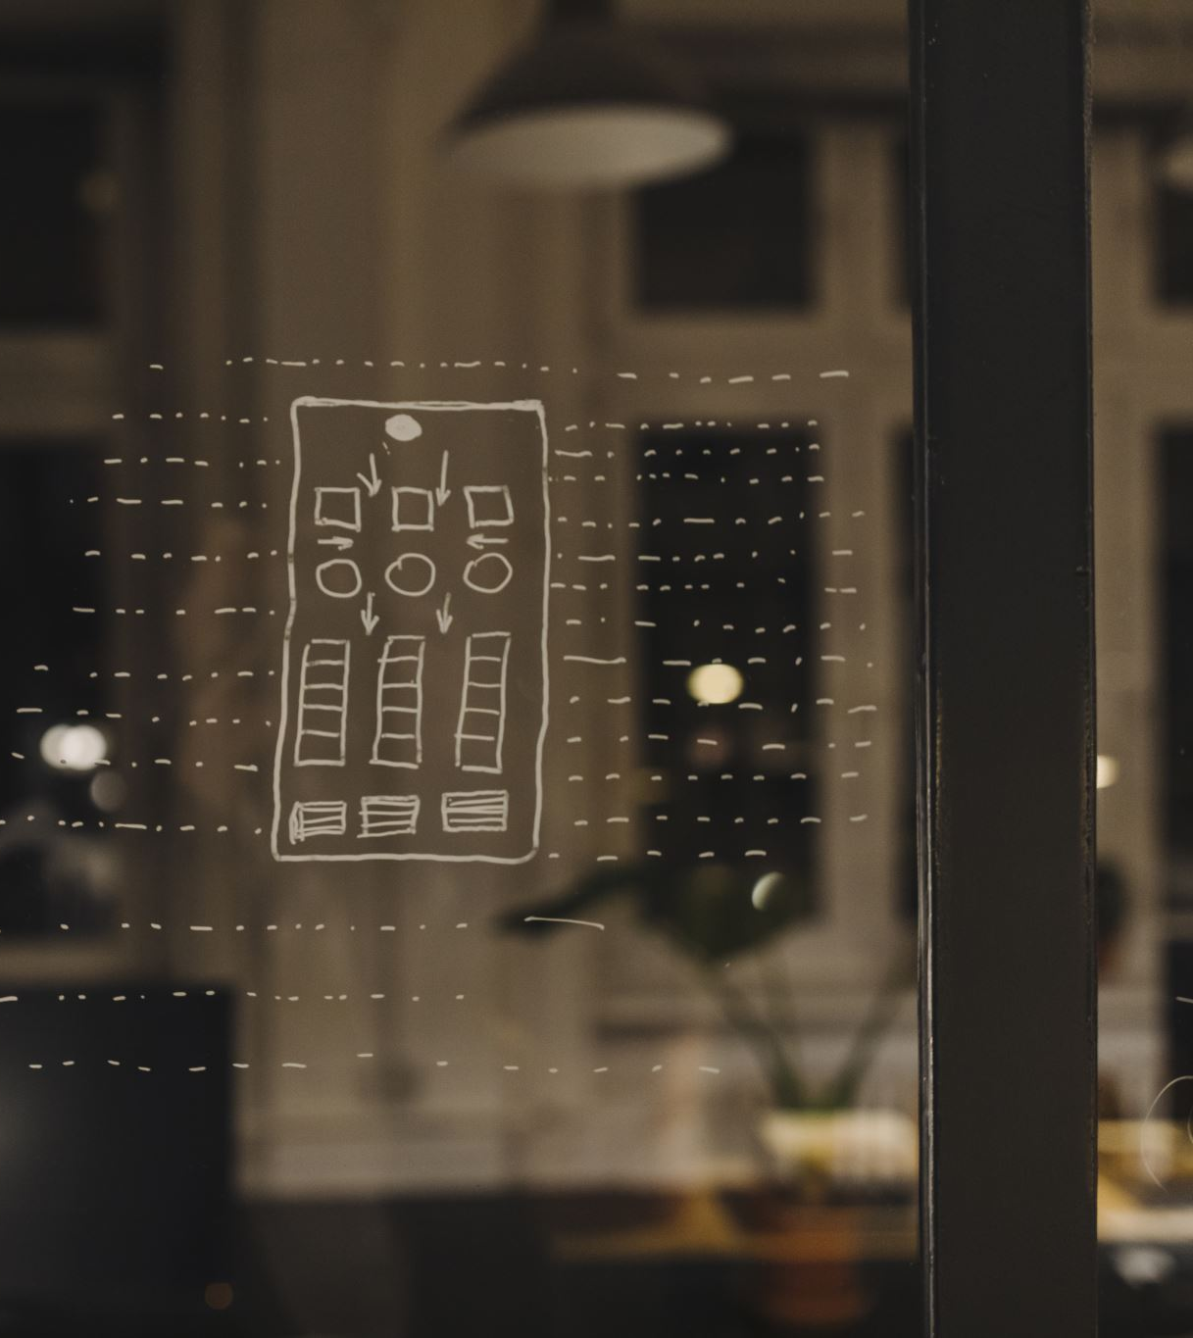

Virtual Kitchen Management: Machine Learning Object Detection and YOLO Model Integration in Restaurants
Virtual Kitchen Management
Date: 15 May 2024

Slide 2
Virtual Kitchen Management
Supervisor | External
MD. MASUM BILLAH | SYED NAFIUL SHEFAT
billah.masumcu@aiub.edu | nafiul.shefat@aiub.edu

Slide 3




Thesis Member
Name | ID | Email | Author’s Portrait
SAIFUL ISLAM | 20-42667-1 | 20-42667-1@student.aiub.edu
JABER MD OASIK​ | 20-42523-1​ | 20-42523-1​@student.aiub.edu
Hasan, Md. Rakibul​ | 17-35020-2​ | 17-35020-2​@student.aiub.edu
ABU ABDULLAH | 20-43966-2 | 20-43966-2@student.aiub.edu

Slide 4
Content/Outline
Introduction
Background Study
Motivation
Methodology
Experimental Analysis
Result Analysis
Limitations & Future Work
Conclusion
References
Q&A

Slide 5
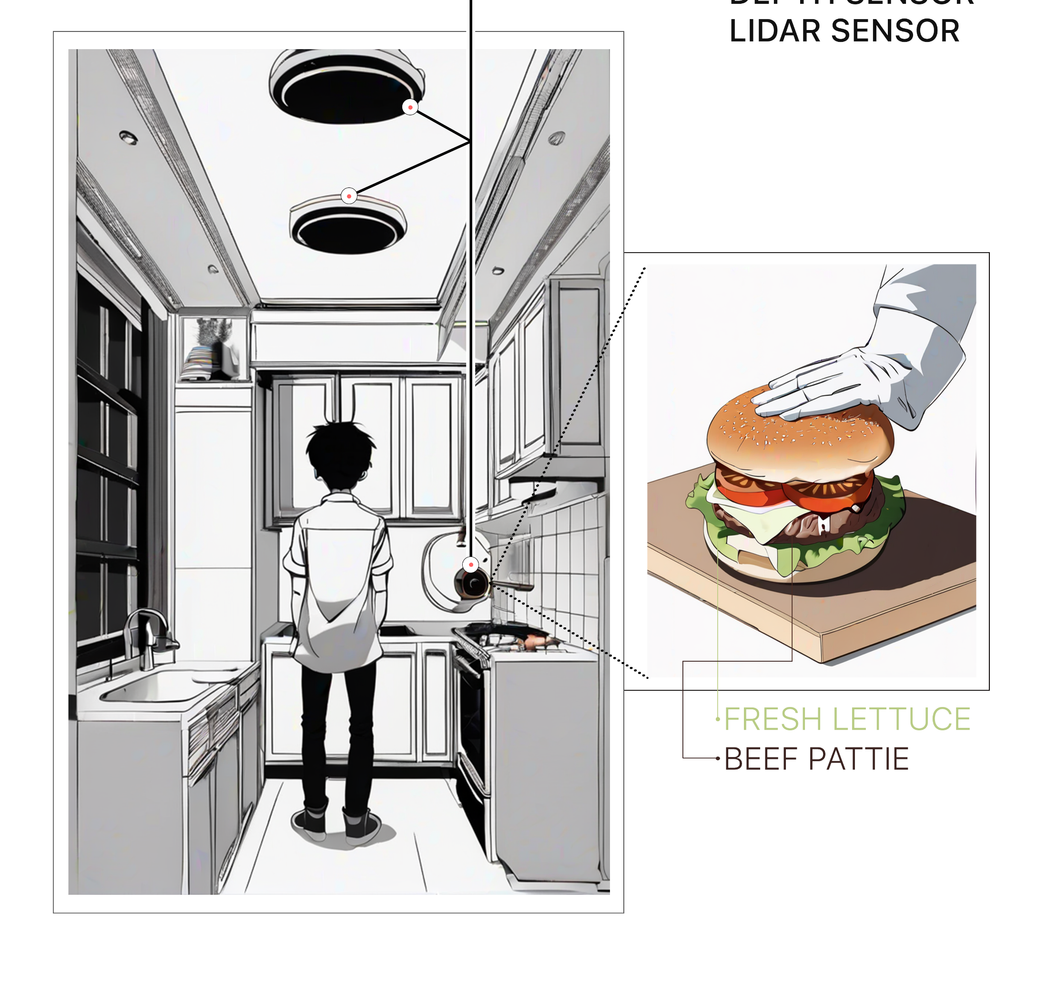
Introduction
VR/AR food preparation monitoring systems.
core functionalities of the proposed system.
the benefits for restaurants (increased transparency, improved efficiency) and customers (enhanced trust, visual engagement).

Slide 6

Background Study
existing food preparation monitoring manual checklists on Foodpanda
Computer vision and its applications in food recognition and tracking.
Existing VR/AR applications in the food industry menu visualization
Limitations of current approaches. lack of real-time feedback, limited data capture, absence of user engagement
how the proposed VR/AR system addresses these limitations.

Slide 7

Motivation
the rationale behind developing this VR/AR food prep monitoring system.
specific challenges addressed by the system. ensuring ingredient accuracy, enhancing customer trust
Potential benefits of VR and AR implementation

Slide 8
Motivation
How to set up a virtual environment system in the kitchen and customers both sides?​
How to train models on CNN, YOLO, R-CNN?​
​How image processing models work?​
How to ensure data privacy and security within a virtual kitchen environment?​
What are the significant challenges in implementing virtual kitchen management systems?

Slide 9
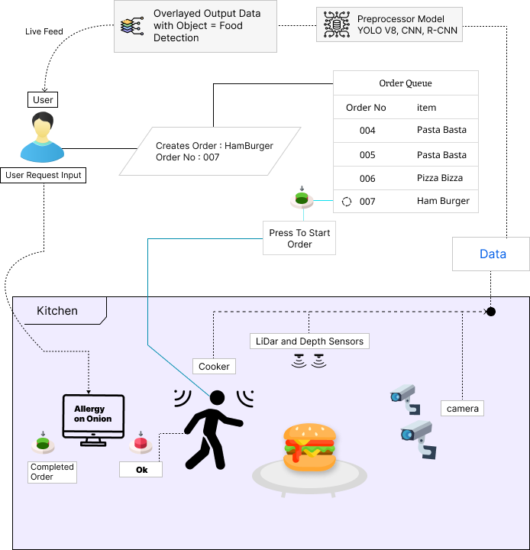
Methodology
Overview of the proposed model
Aligning methodology with project goals
Integration of VR, AR, and backend infrastructure
Image dataset collection of various food items
training object detection/recognition models

Slide 10
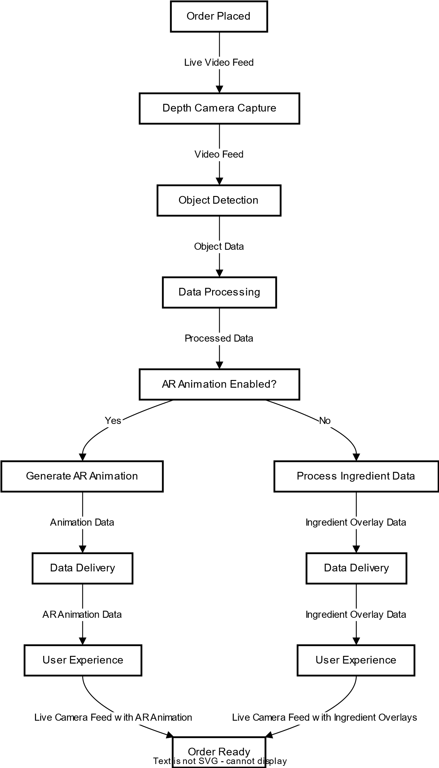
Methodology
system architecture with diagram

Slide 11
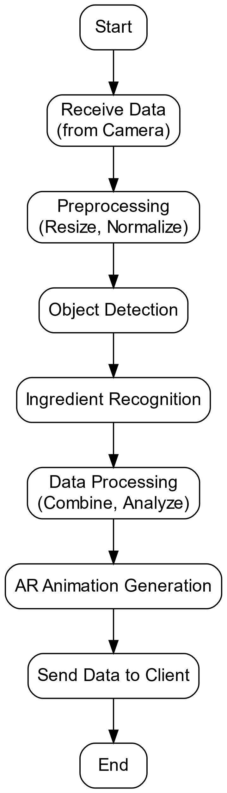
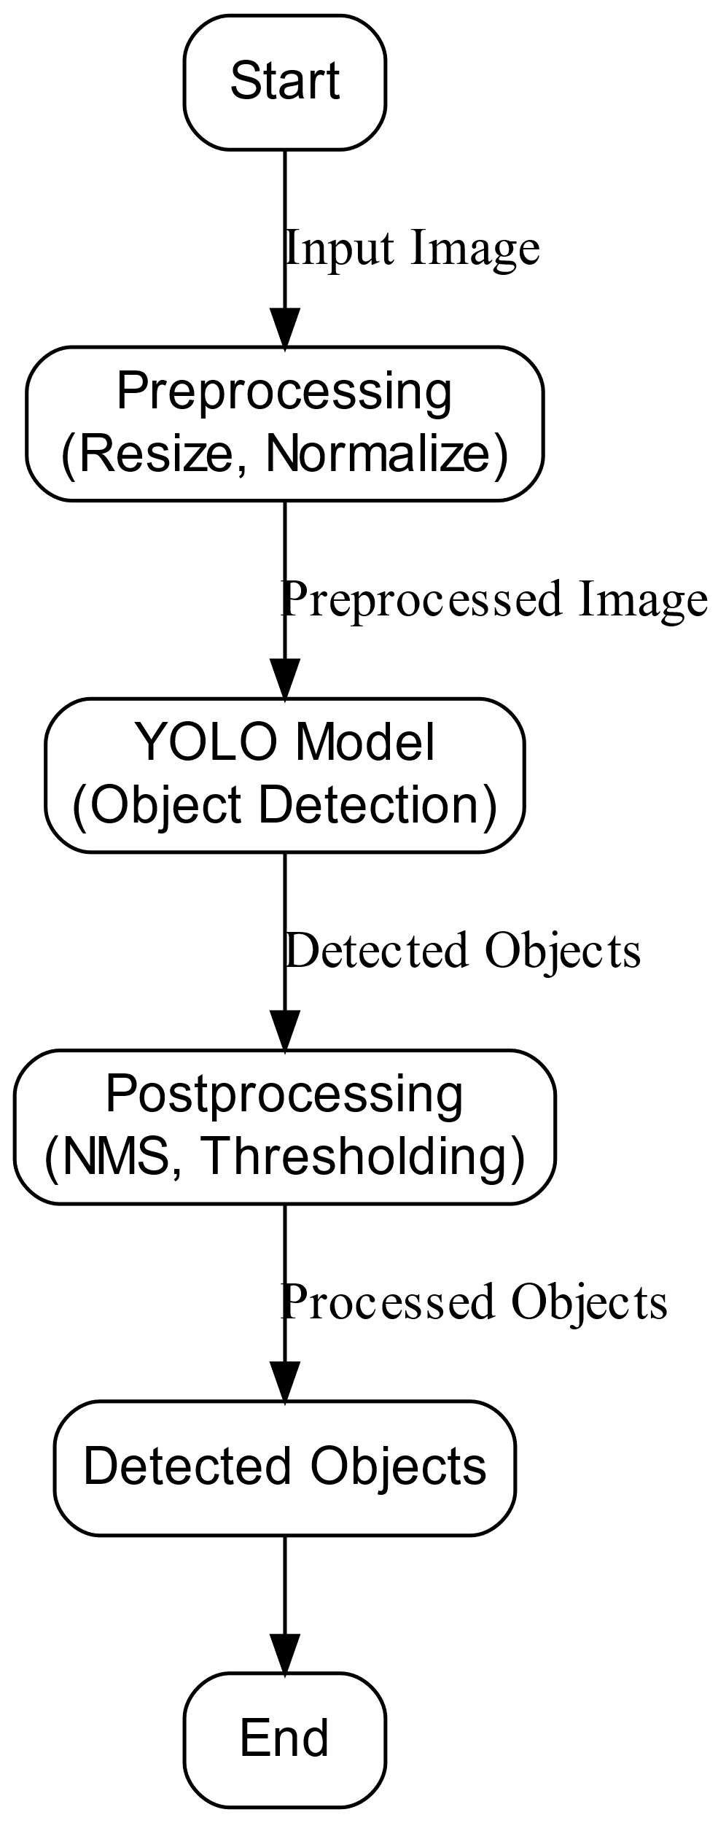
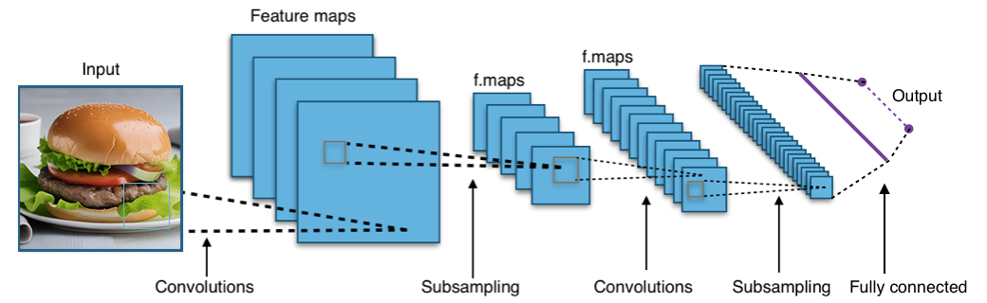
Methodology
core components restaurant-side data acquisition, server integration
object detection and choice of model YOLO/CNN/R-CNN
ingredient recognition model (YOLO) and its training process
Object Detection Convolutions & Sampling
Training From Input to Output
Server Side
Integration
YOLO Working Procedure

Slide 12
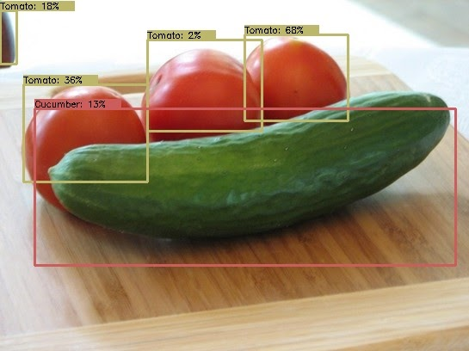
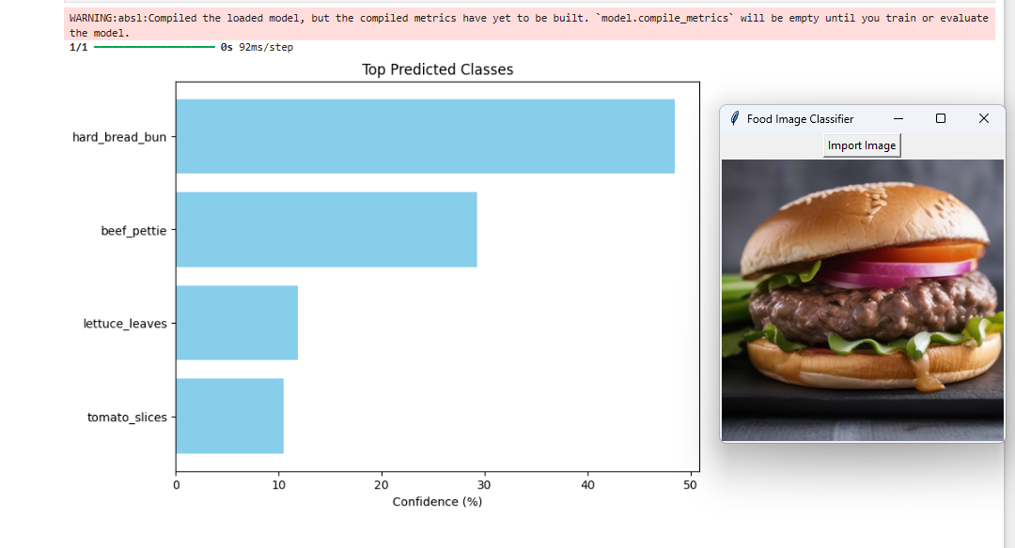
Experimental Analysis
Testing with Burger Making Process.
Data collection methods
the accuracy of ingredient recognition
Object DetectionYOLO model
Classification CNN model

Slide 13
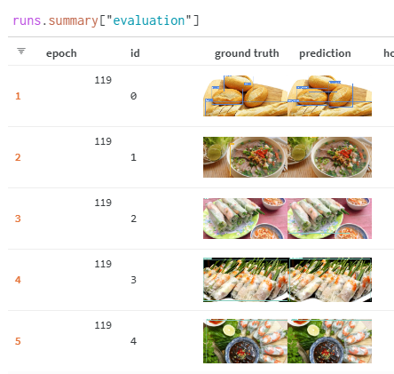
Result Analysis
training performance of the ingredient recognition model

Slide 14
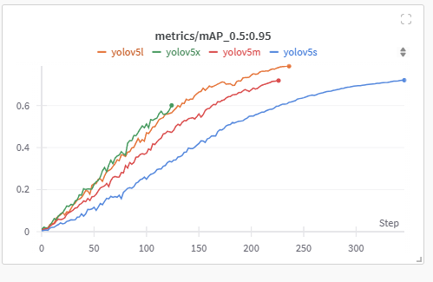
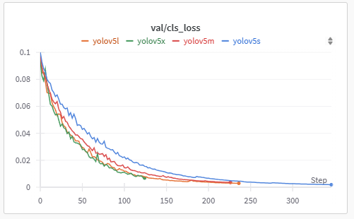
Result Analysis
metrices/precision curve
val/loss curve

Slide 15
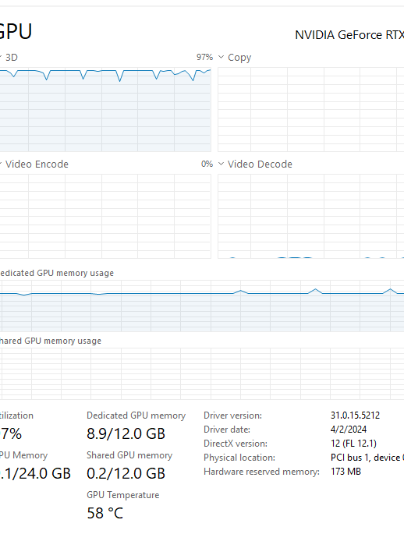
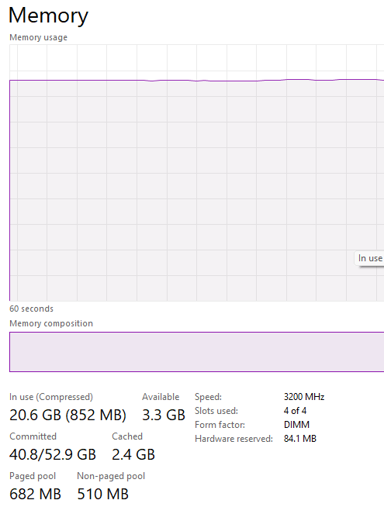
Limitations
new ingredient recognition accuracy or object detection
Hardware Resources Getting Bottleneck

Slide 16
Future Work
model accuracy and robustness
using post trained with object detection while new items/ ingredients are found

Slide 17
Conclusion
Enhanced transparency and trust in food preparation processes
Improved efficiency and monitoring capabilities for restaurants
Increased customer engagement and satisfaction

Slide 18
References
[1] Joseph Redmon, Santosh Divvala, Ross Girshick, “You Only Look Once: Unified, Real-Time Object
Detection”, The IEEE Conference on Computer Vision and Pattern Recognition (CVPR), 2016, pp. 779-788
[2] Liu, C., Cao, Y., Luo, Y., Chen, G., Vokkarane, V., & Ma, Y. (2016). Deepfood: Deep learning-based food
image recognition for computer-aided dietary assessment. In Inclusive Smart Cities and Digital Health: 14th
International Conference on Smart Homes and Health Telematics, ICOST 2016, Wuhan, China, May 25-27, 2016.
Proceedings 14 (pp. 37-48). Springer International Publishing.
[3] Nguyen, C.H., Cai, Chen, F.: Automatic classification of traffic incident’s severity using machine learning
approaches. IET Intel. Transp. Syst. 11, 615–623 (2017)
[4] Zhao-Min Chen, Xiu-Shen Wei, Peng Wang, Yanwen Guo; Proceedings of the IEEE/CVF Conference on
Computer Vision and Pattern Recognition (CVPR), 2019, pp. 5177-5186
[5] Bochkovskiy, A., Wang, C., & Liao, H. (2020). YOLOv4: Optimal Speed and Accuracy of Object Detection.
ArXiv. /abs/2004.10934
[6] Food Recognition by Hoang Lan Nguyen https://github.com/lannguyen0910

Slide 19
Q&A
Your Thoughts are Valuable to us.

Slide 20
Thank You

